Slide 1
Machine Learning Project
Predicting Survival Status of different people using Titanic Dataset

Slide 2
Task
To Preprocess, Apply 10 classification algorithms using scikit_learn in python for training and testing and then analyzing the predictions made by those algorithms using different methodologies.

Slide 3
Different phases of the Project
Data preprocessing
Training
Testing
Application
Feedback and Improvement

Slide 4
Input-Output representation
Input representation
Feature | Type | Possible values
Gender | Categorical | Male/Female
Pclass | Numeric | 1,2,3
Siblings | Numeric | 0,1,2,3,4,5,8
Embarked | Categorical | C,S,Q
Output representation
Feature | Type | Possible values
Survived | Categorical | Yes/No

Slide 5
1. Data preprocessing phase
Different steps involved in data preprocessing according to the data
Removing the rows having missing values from dataset
Using Onehot Encoding measures
Using principal component Analysis
Standardization

Slide 6
2. Training Phase
We have to train 10 classification algorithms using two evaluation methodologies
80/20 Train-Test split
K fold Cross Validation where k = 10 is suitable for our dataset

Slide 7
Classification Algorithms
Logistic Regression
Decision Tree
Support Vector Machine
Naïve Bayes
KNN
Random Forest
Artificial Neural Networks
Stochastic Gradient Descent

Slide 8
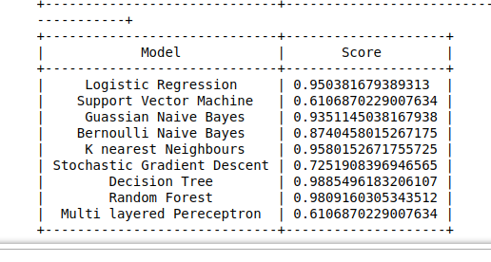
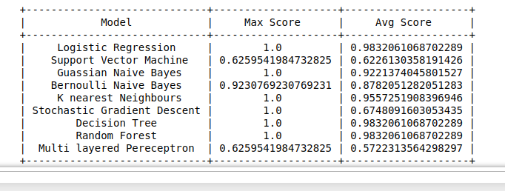
3. Testing Phase
80/20 Train-Spilt accuracy scores
K-Fold Cross Validation accuracy scores

Slide 9
3. Testing Phase
Evaluation Metrics
Evaluation metrics which are used in this project are
Recall (Sensitivity)
Precision (False Positive Rate)
F1
Accuracy

Slide 10
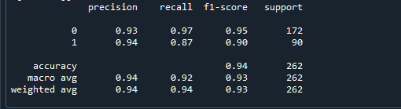
3. Testing Phase
Evaluation Metrics

Slide 11
4. Application Phase
Logistic regression will be used in order to predict future instances due to its high performance
GUI application will take inputs regarding different attributes of a particular instance and will predict its survival status in the real time.

Slide 12
5. Feedback and Improvement
Feedback will be taken regarding the performance of our model and will be tuned according to the requirements

